Slide 1



SEVERN SCHOOL OF SURGERY
Core Trainee Surgical Training Programme
2011/2012

Slide 2
Core Trainee
Surgical Training Programme
Welcome to the outlying Deanery for core surgical training!
PMETB 2010 survey for core surgical skills training

Slide 3
Core Trainee
Surgical Training Programme
Anatomy Teaching (CT1)
Physiology Teaching (CT1)
Core Training Knowledge Days (CT1 and 2)
Surgical Skills Training (CT1 and 2)
Human Factors Training (CT2)

Slide 5

Anatomy and Physiology Teaching
Learning support for the MRCS examinations and continuing surgical education
Tailor-made curriculum
Specialist educators with clinical backgrounds
World-class learning facilities
    Centre for Clinical and Comparative Morphology
    CETL AIMS

Slide 6
Anatomy Teaching
5 modules
  Thorax and spine
  Abdomen and pelvis
  Upper limb
  Lower limb
  Head, neck and neuroanatomy
  Each module is run twice to allow attendance.
  Each module is compulsory

Slide 7

Physiology Teaching
4 modules
  Applied physiology of shock
  Applied physiology of hypoxia and hypercapnia
  Regulation of blood volume and osmolarity: physiology and pathophysiology
  Pain. Acid-base balance
  Each module is run twice to allow attendance.
  Each module is compulsory
The Applied and Integrated Medical
Sciences Centre for Excellence in Teaching and Learning (AIMS CETL)

Slide 9
Core Training Knowledge Days
Five training days across the Deanery per year
Topics will include;
  Audit and Research
  Cardiothoracics
  Consent
  Emergency surgery
  Errors and reduction strategies
  ‘How to teach’
  Neurosurgery
  Palliative care
  Plastics and Burns
  The NHS, management and leadership
100% mandatory attendance over 2 years

Slide 11
Surgical Skills Training
New programme for developing surgical skills (specifically designed for core surgical trainees in the Severn School of Surgery)
Senior clinical faculty
Fully equipped facilities;
    Skills Lab, Royal United Hospital, Bath
    Education Centre, Gloucestershire Royal Infirmary, Gloucester
    Education Centre, Musgrove Park Hospital, Taunton

Slide 12
Surgical Skills Training
CT1 surgical skills day (T&O and SiG)
    Compulsory
    2 dates to allow attendance (only one is compulsory)
      Gloucester and Taunton
CT2 surgical skills day (SiG only)
    Compulsory
    2 dates to allow attendance (only one is compulsory)
      Gloucester and Bath

Slide 13
Surgical Skills Training
Orthopaedic Surgical Skills
    To be arranged
    James Livingstone (T&O PD)
    Attendance to be announced
    Topics to be announced
    Dates awaited

Slide 15
Human Factors Training
Bristol Medical Simulation Centre
World class facilities
Human factors and non-technical skills training
Compulsory for CT2s (2 dates available to allow attendance)

Slide 16
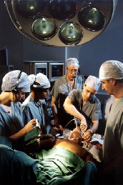
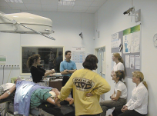

Bristol Medical Simulation Centre
- Interactive human patient simulators and manikins
- Life support and critical care training
Team-based clinical scenario training
Human factors training

Slide 18
Register on-line early
• On-line feedback forms
• Non-attendance forms on-line
• Complete your study leave forms (for all training days) to facilitate your Trust’s cover arrangements
• Co-ordinate your attendance with your core surgery trainee colleagues
• Late attendance is not tolerated – you will be turned away
• Full attendance records available for PDs at ARCPs
Core Trainee
Surgical Training Programme

Slide 19
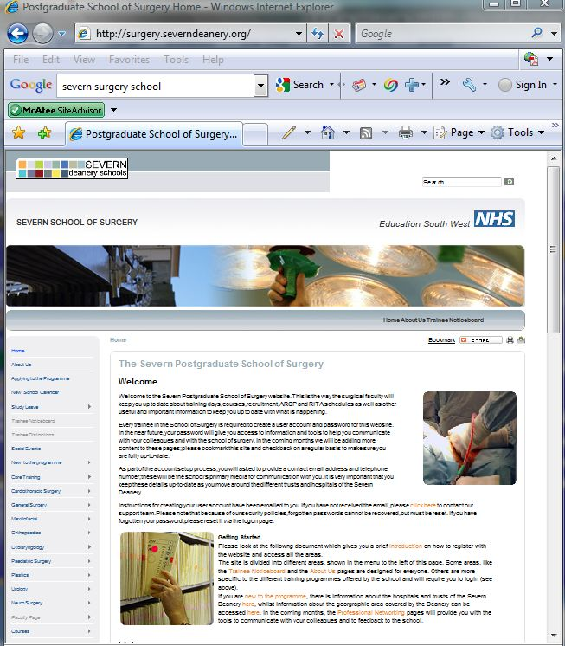
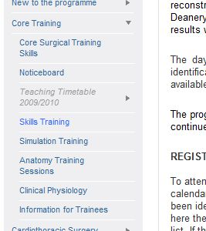
http://surgery.severdeanery.org
On-line registration
Duplication of teaching and skills training days
Set number of places

Slide 21
MRCS part B OSCE Exam Course
Pilot for Plastics Surgery Training Course for Core Trainees
Planning for ST3 Course – under development
CrISP, BSS, ATLS
Other training course opportunities

Slide 22
5th, 6th and 7th September 2011
Centre For Clinical and Comparative Anatomy,
University of Bristol
Sponsored by Severn School of Surgery
5 bursaries for Severn Deanery surgical CTs worth £200 each
Severn School of Surgery website for details and application process
Severn MRCS part B OSCE Exam Course

Slide 23
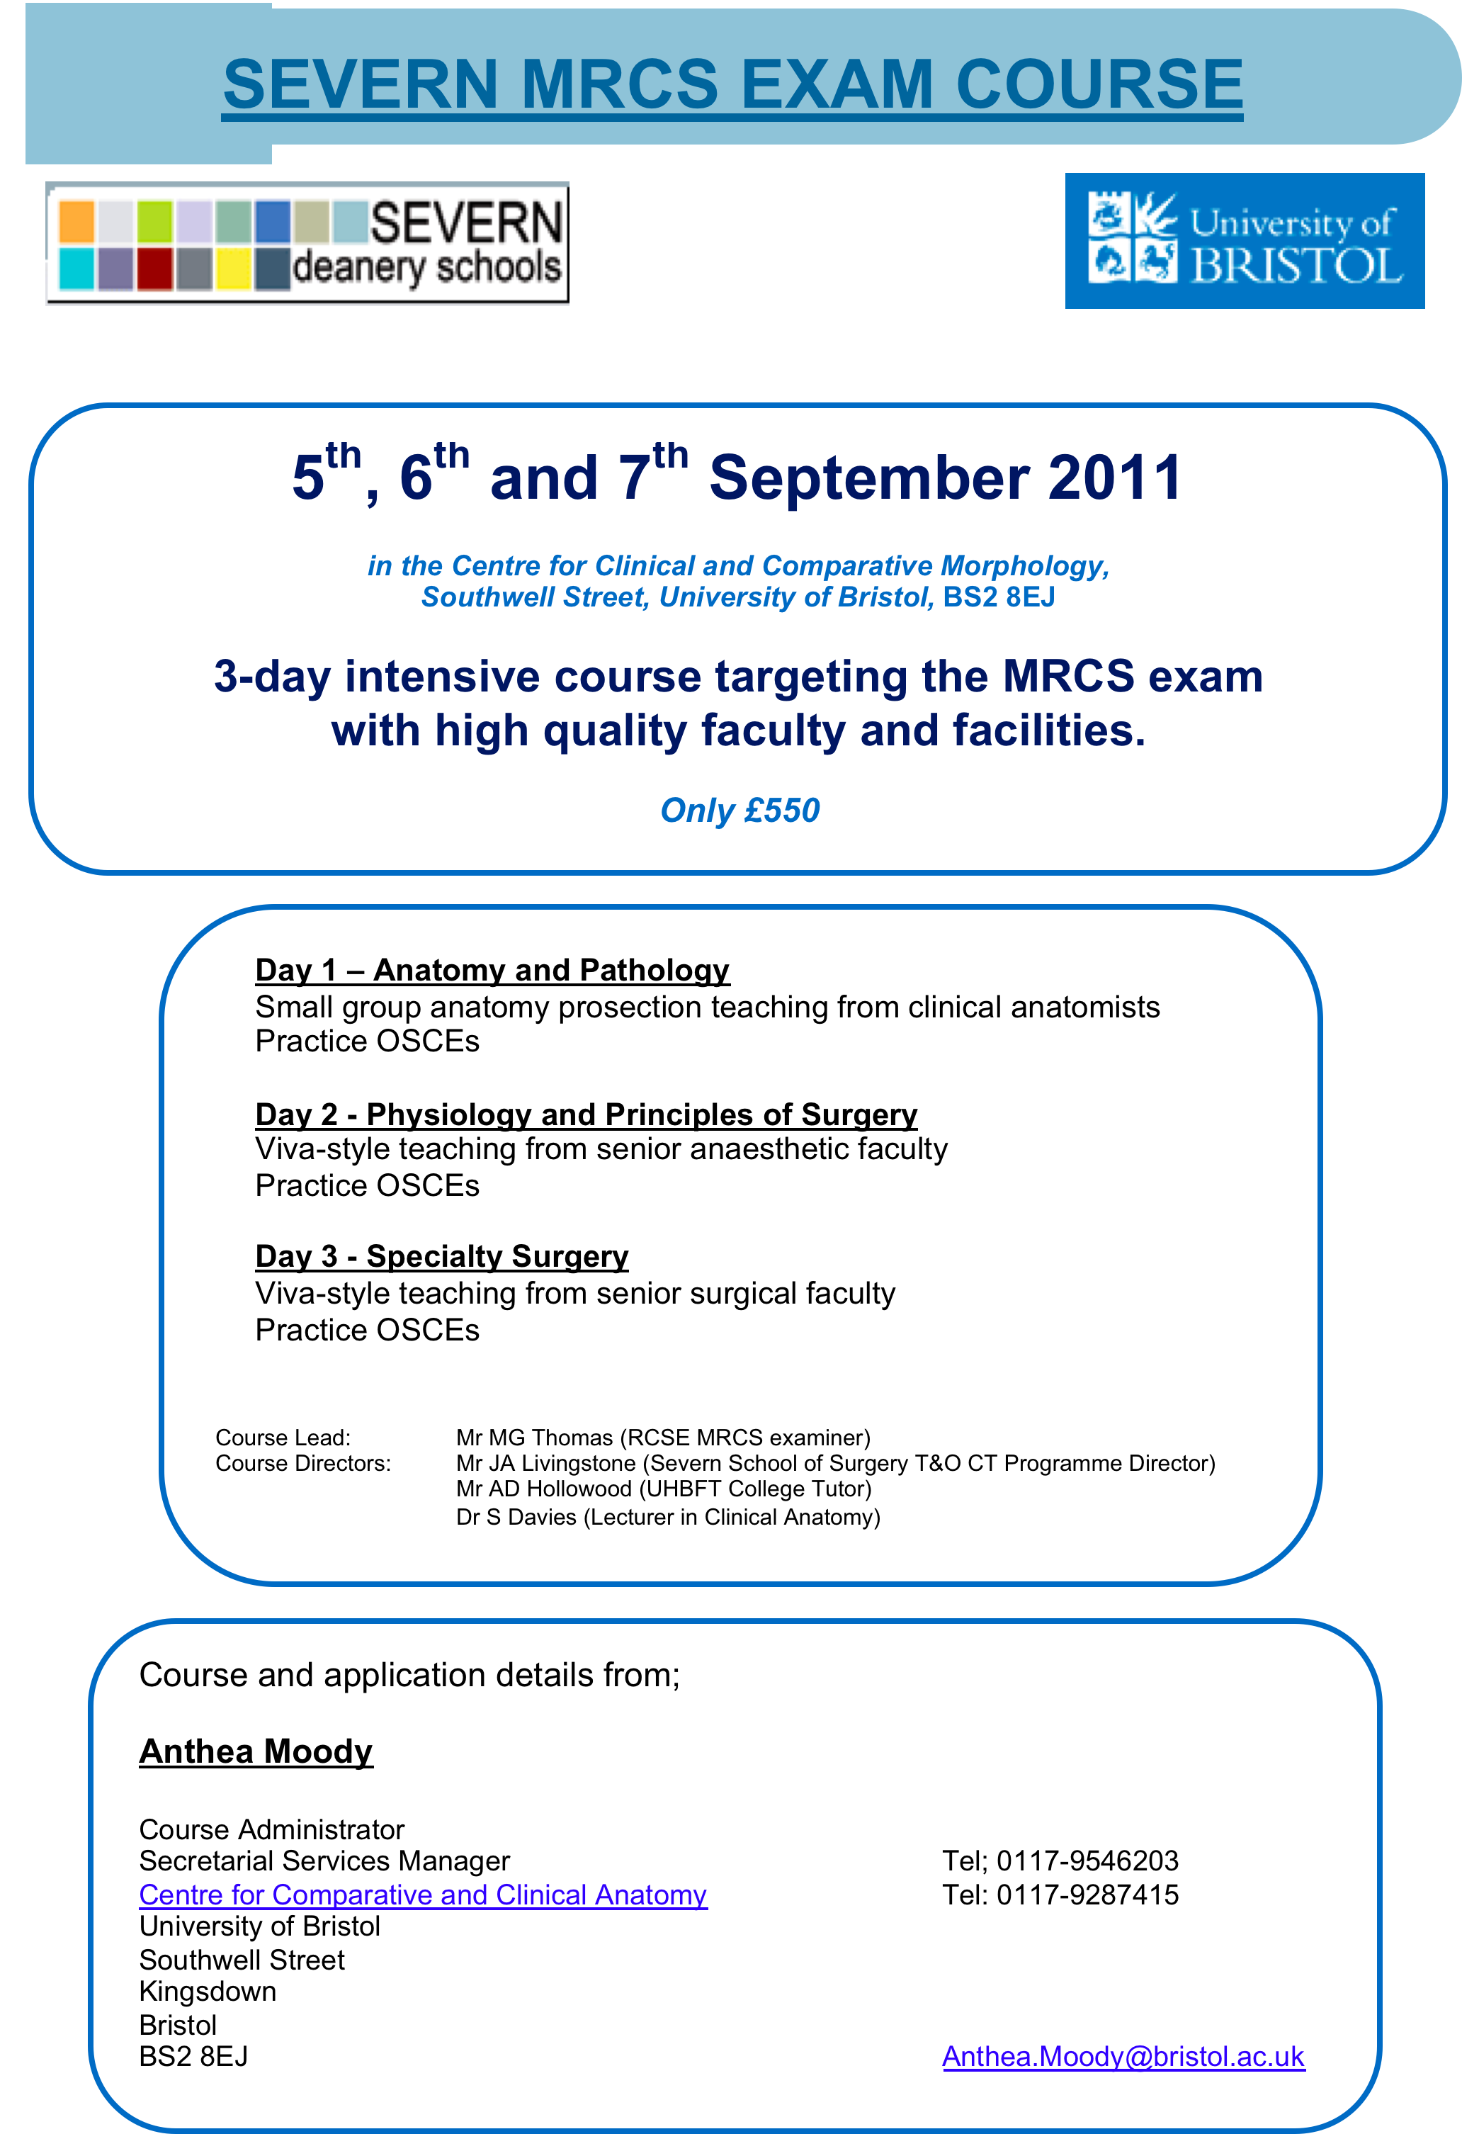

Slide 24
CrISP course
– locally delivered and funded
- we need your names
BSS
– we may be able to fund applications to a locally delivered course (eg; Bristol, Taunton, Gloucester, Bath)
- we need your names
ATLS
– we are unlikely to fund this but…..
- we your names
CrISP, ATLS, BSS

Slide 26
Severn School of Surgery
Core Trainee Programme
You were picked for being good
Now you have the opportunity to be the best
robert.longman@uhbristol.nhs.uk

Slide 27
Enjoy the training!

